Slide 1
RASHTRAKAVI RAMDHARI SINGH DINKAR COLLEGE OF ENGINEERING, BEGUSARAI
PRESENTATION OF MACHINE LEARNING
REPRESENTED BY
ARYAN ANKIT 22105125008
NAVEEN PRAKASH 22105125011
SHEKHAR SANU 22105125013
PRINCE KUMAR 22105125019
AYUSHMAAN SINGH 22105125025
NURUDDIN 22105125027
PAWAN KUMAR 22105125032

Slide 2















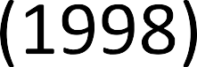






















Slide 3



















Slide 4
HISTORY OF MACHINE LEARNING
1950s – Turing proposes thinking machines
1957 – Perceptron: First learning algorithm born
1980s – Neural nets revived with backpropagation
1997 – Deep Blue defeats world chess champion
2012 – Deep learning wins image competitions
Now – ML powers AI in everything

Slide 5
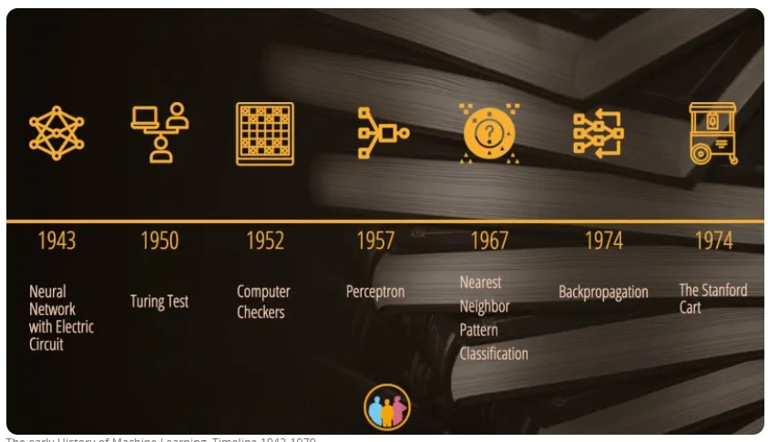

Slide 6

























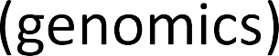

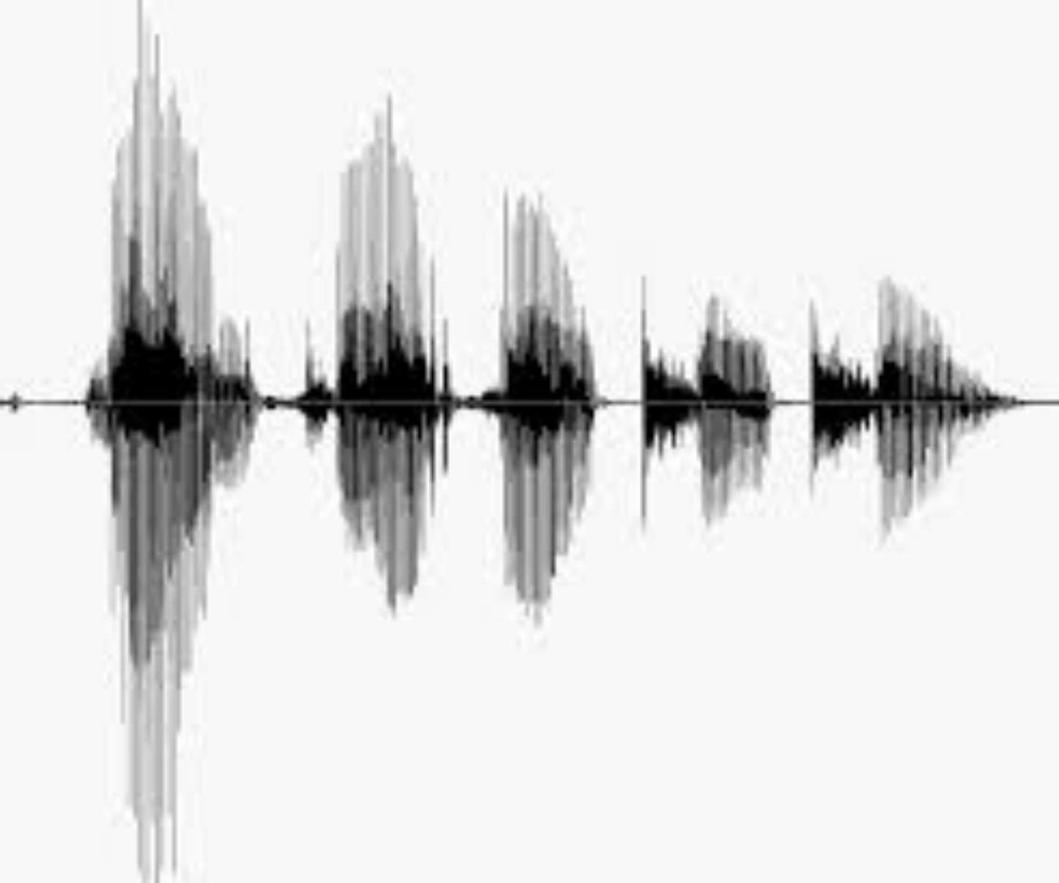
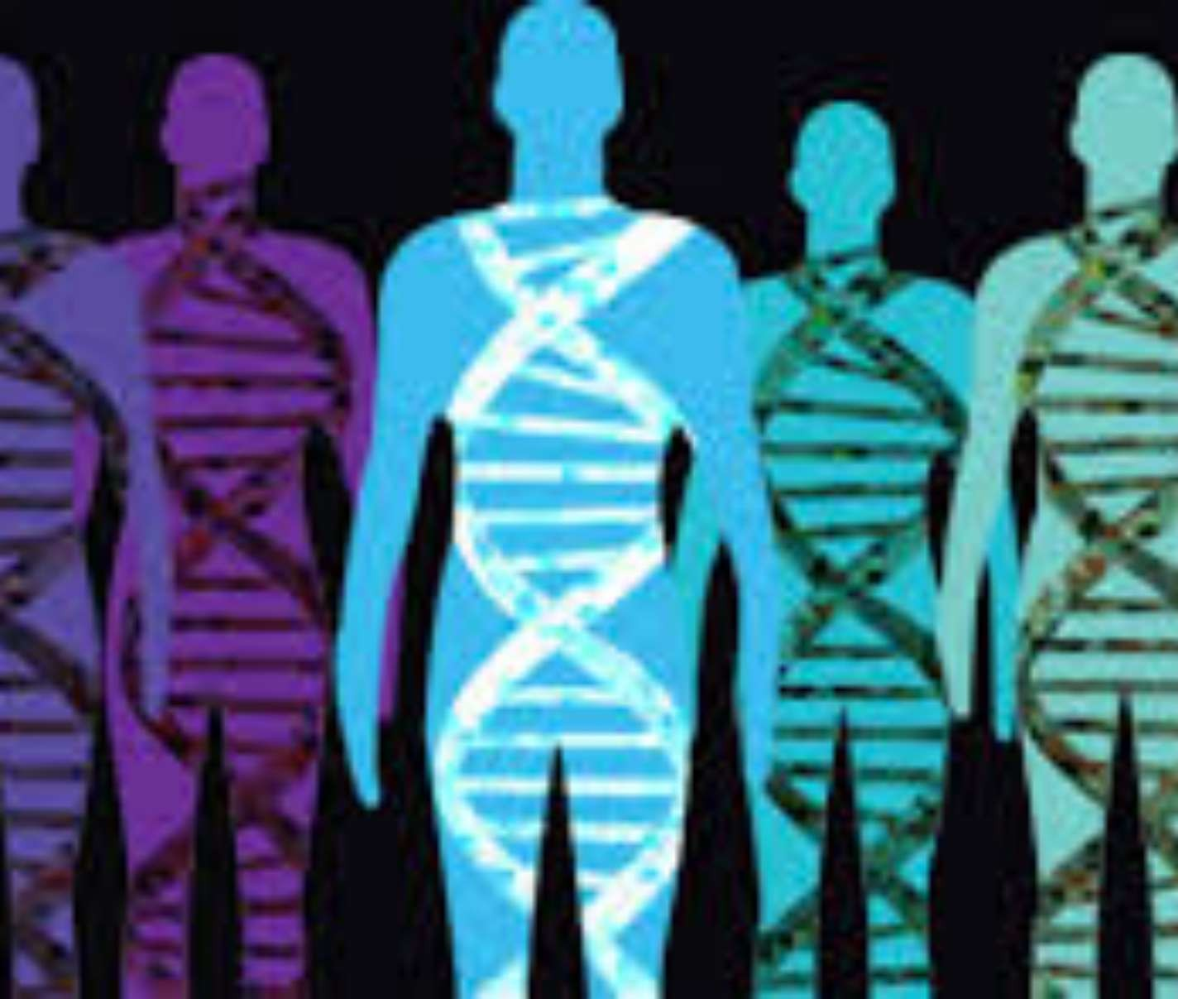
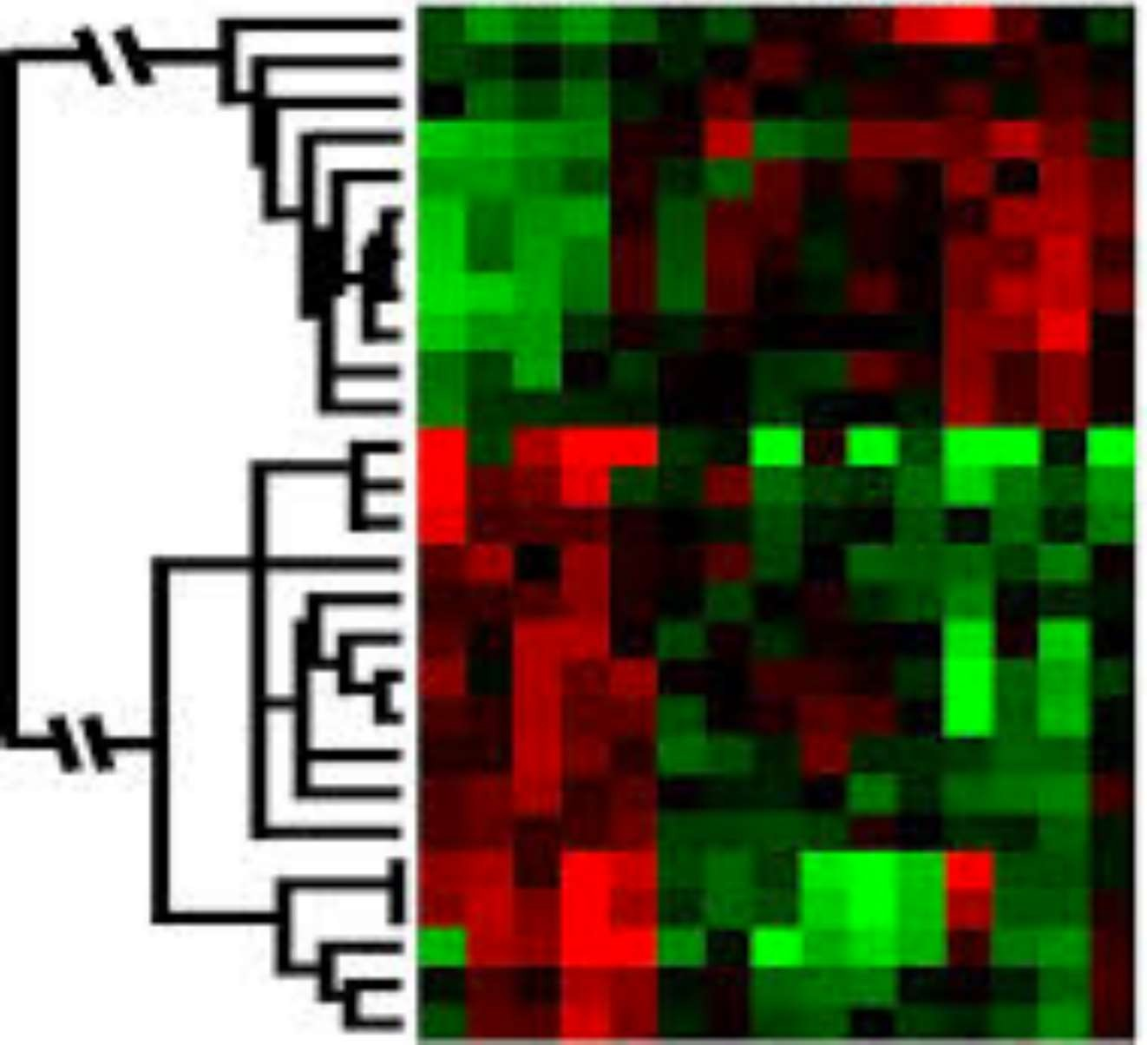











Slide 7




























































Slide 8
SAMPLE APPLICATION
. IMAGE RECOGNITION
. SPEECH RECOGNITION
. TRAFFIC PREDICTION
.PRODUCT RECOMMENDATIONS
.SELF DRIVING CARS
.EMAIL SPAM
.ONLINE FRAUD DETECTION

Slide 9
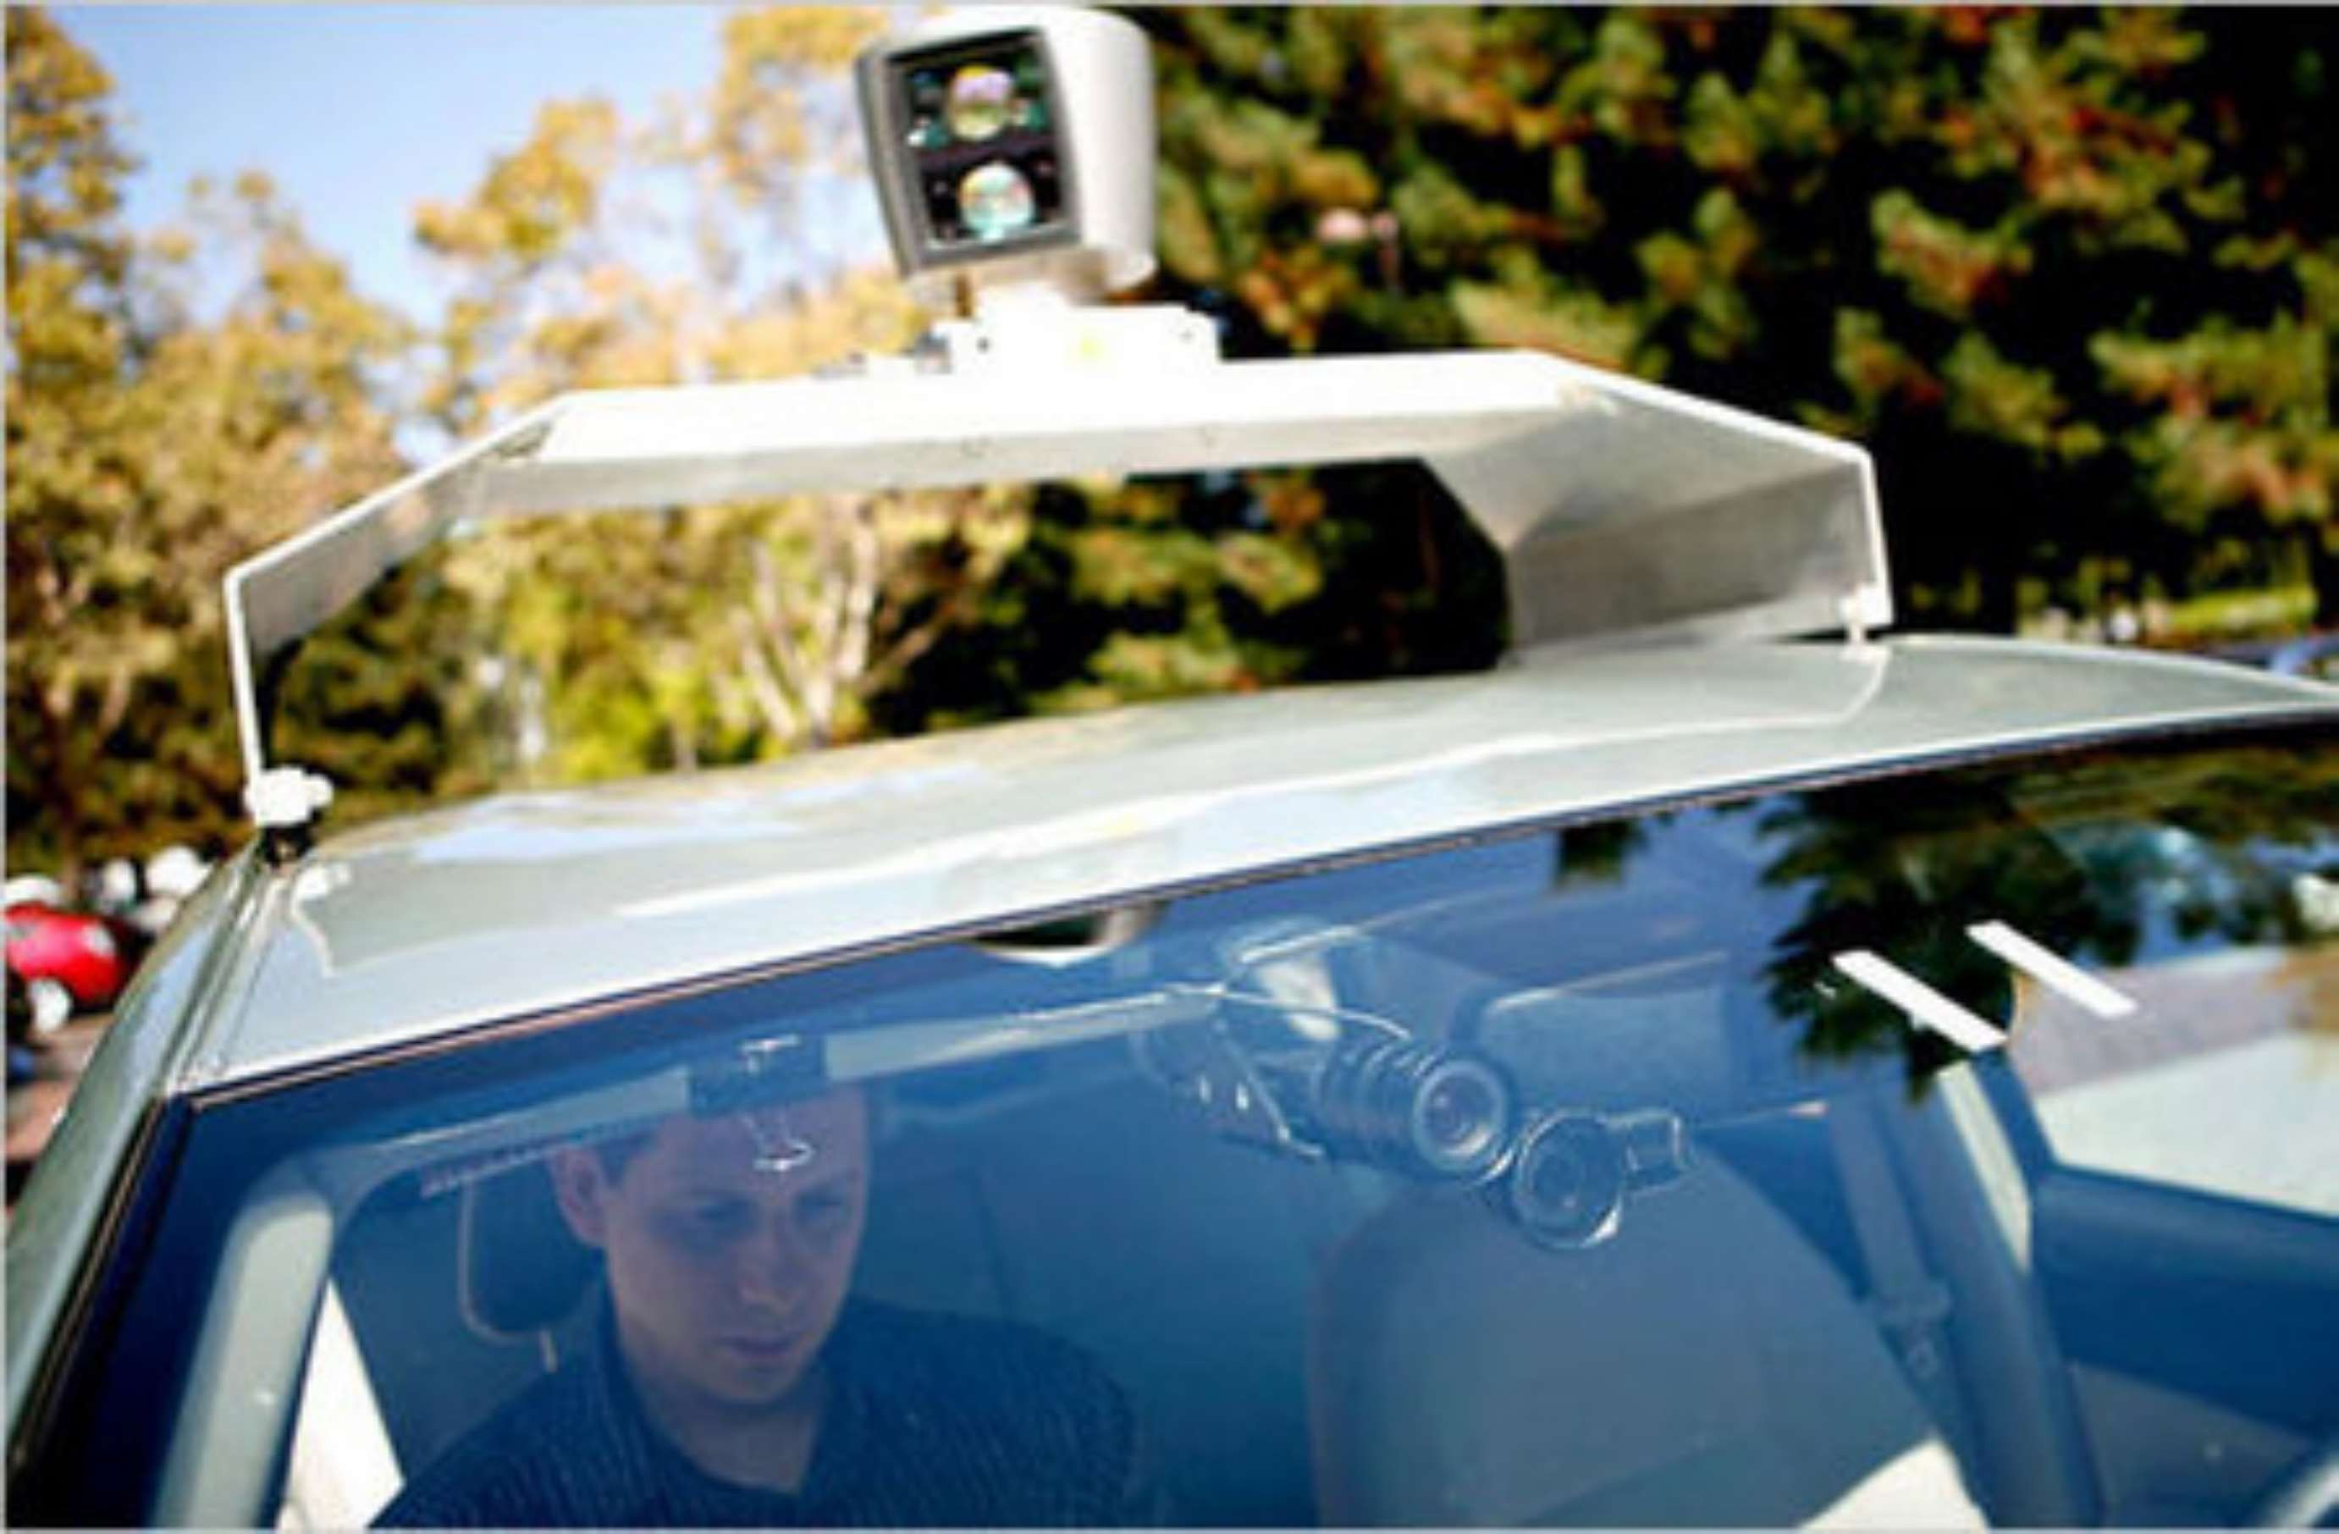
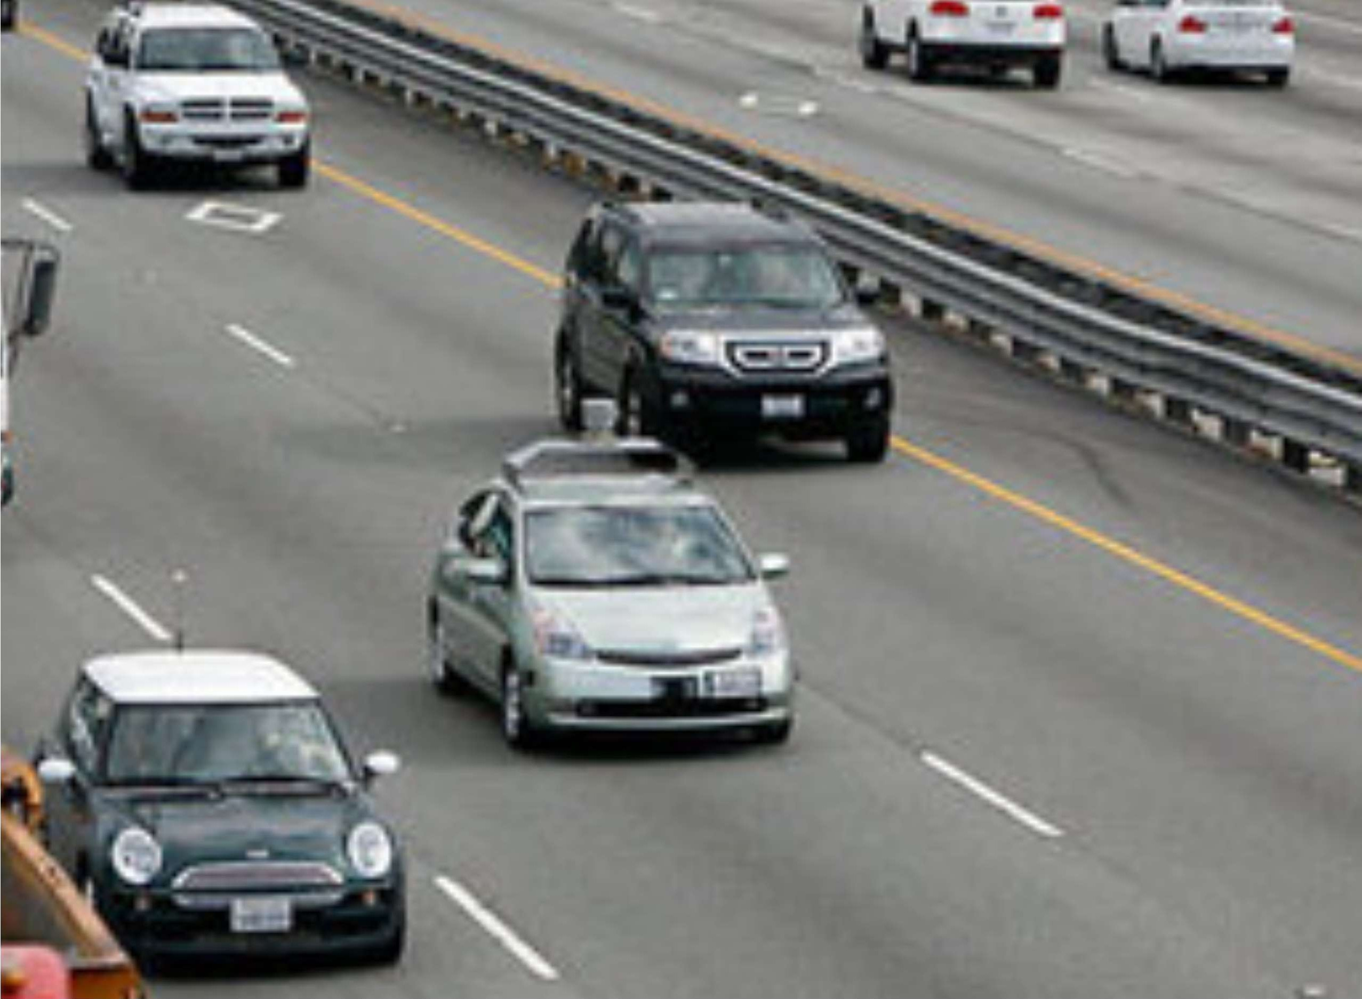




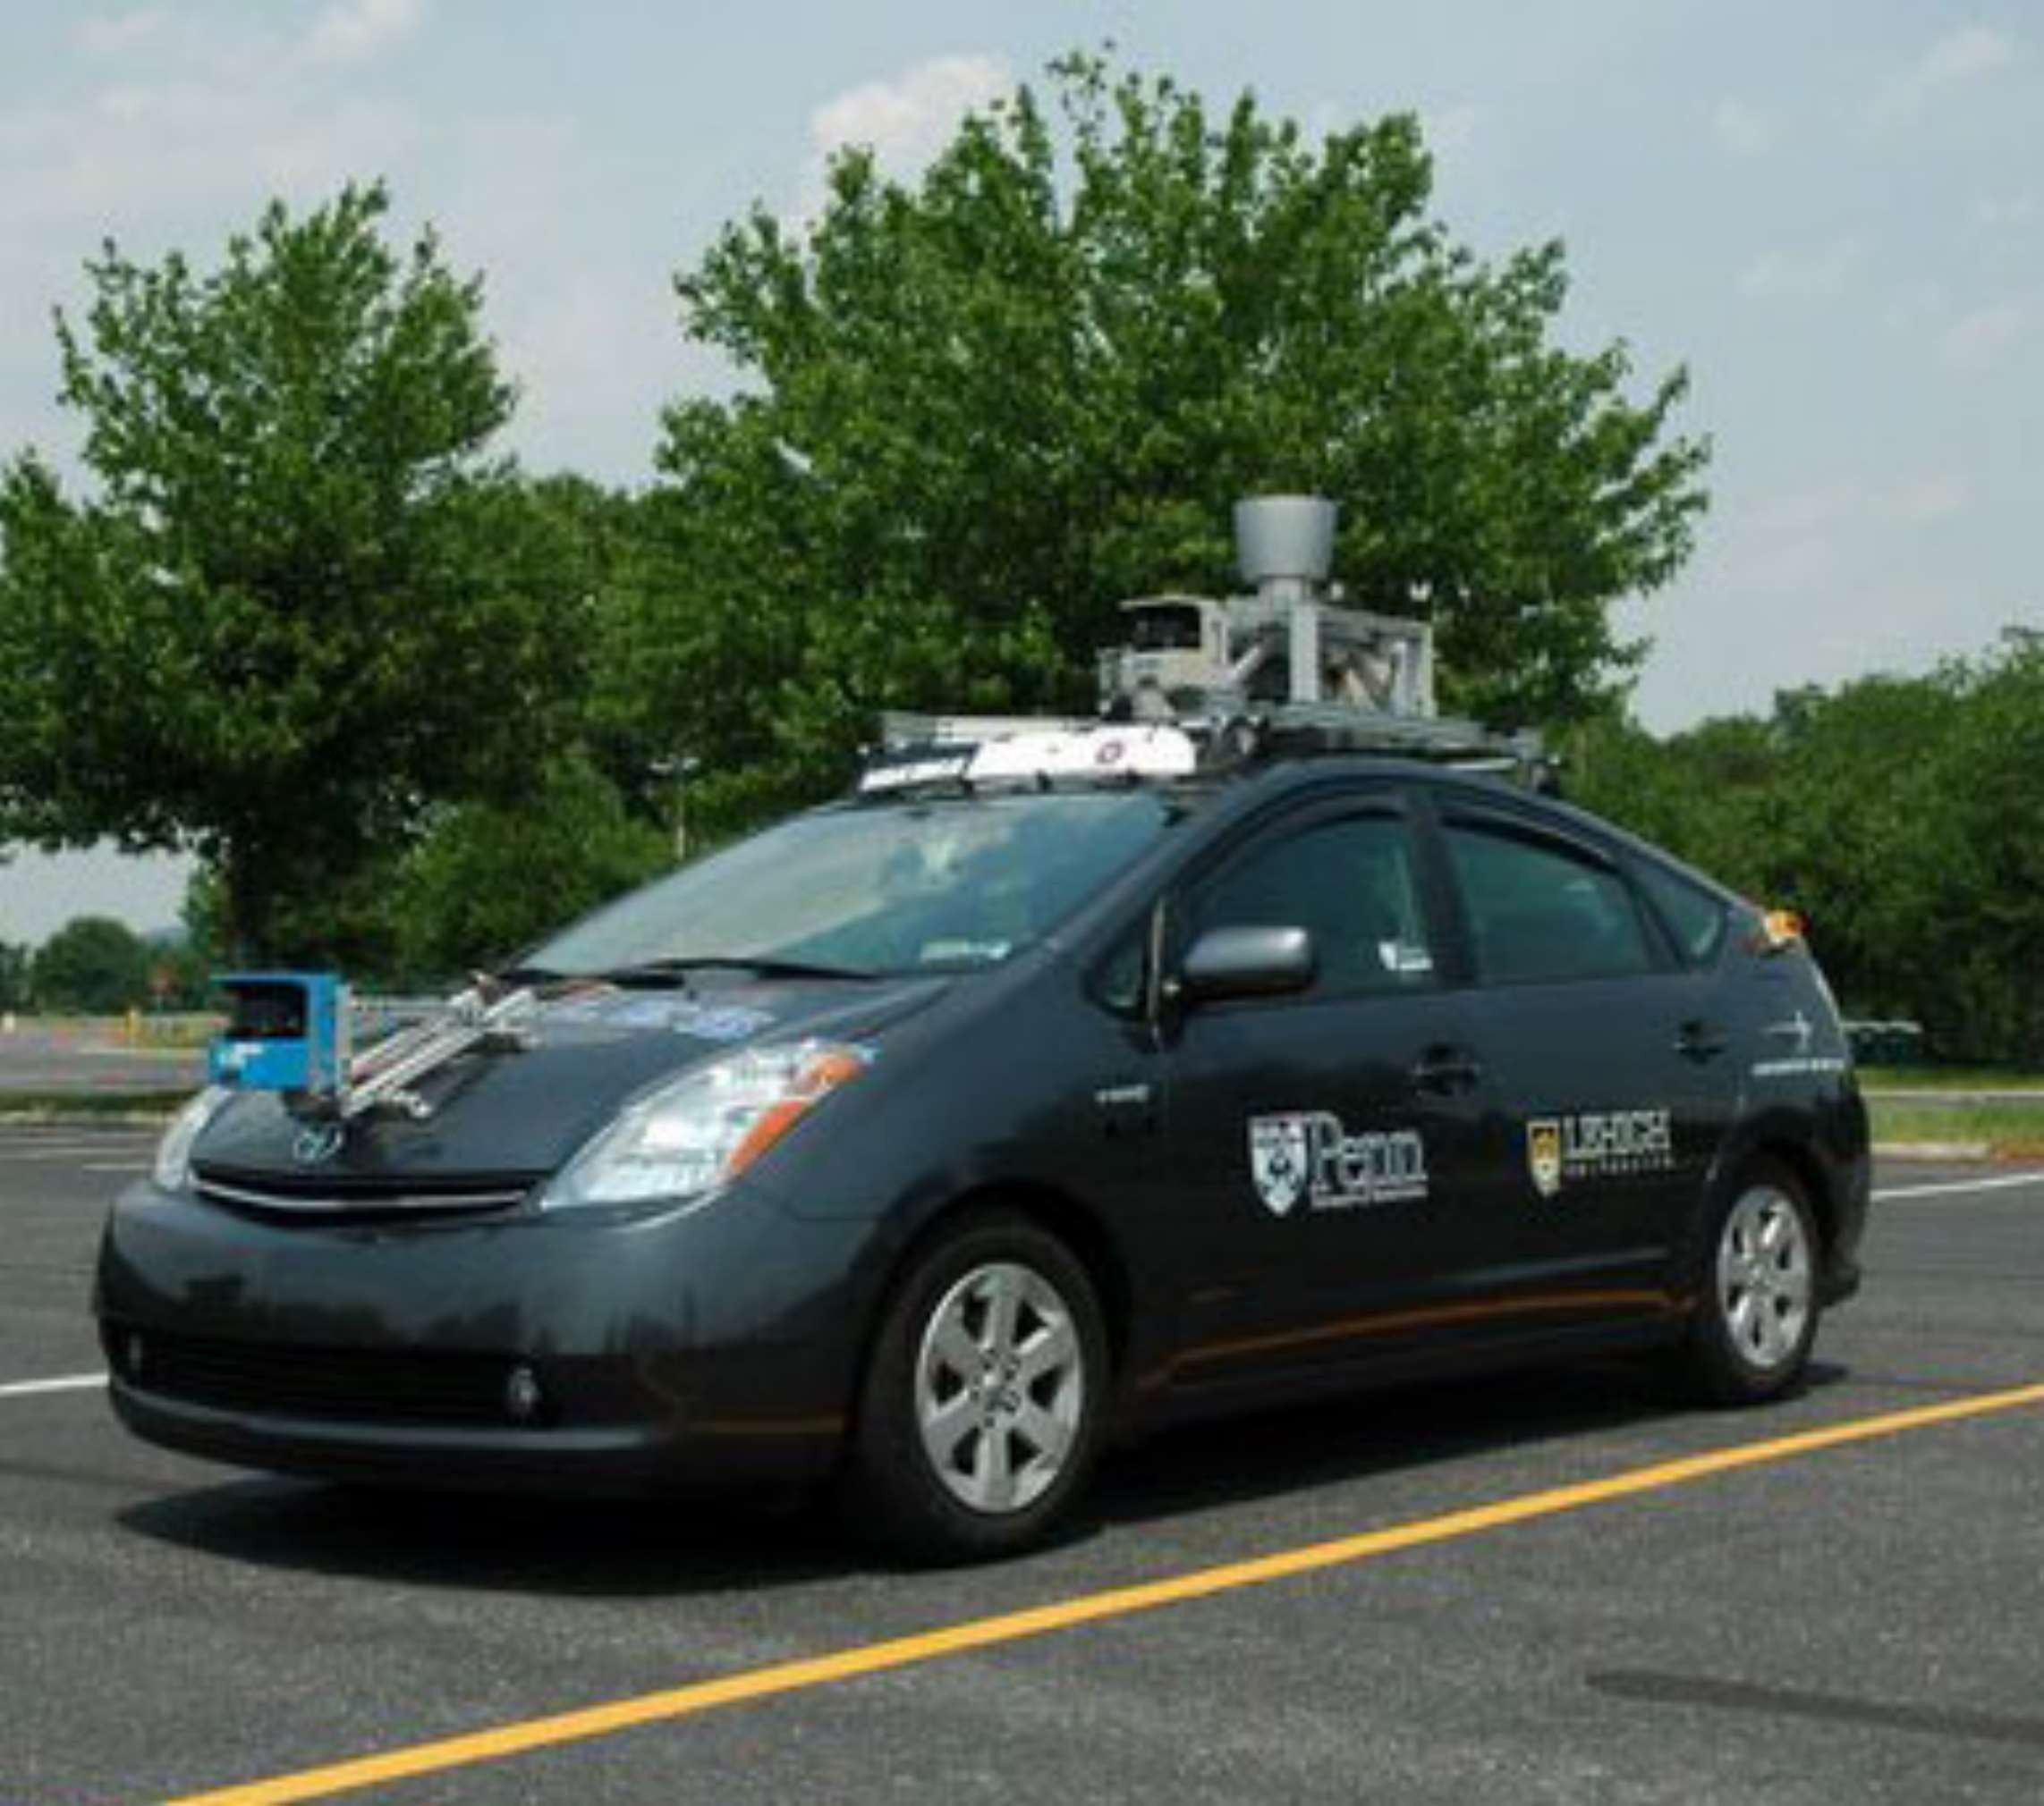


















Slide 10
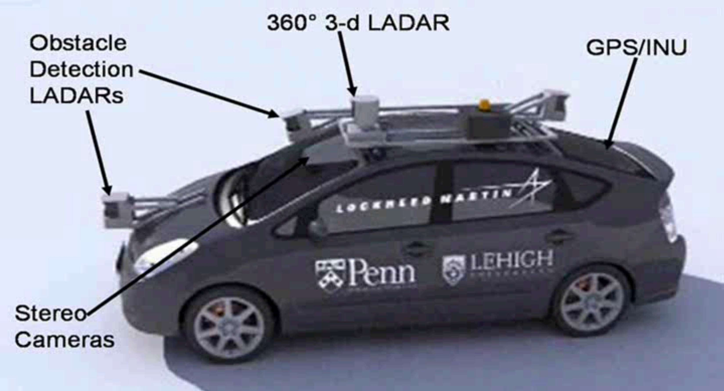

Slide 11
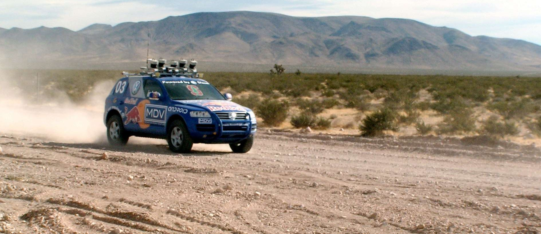
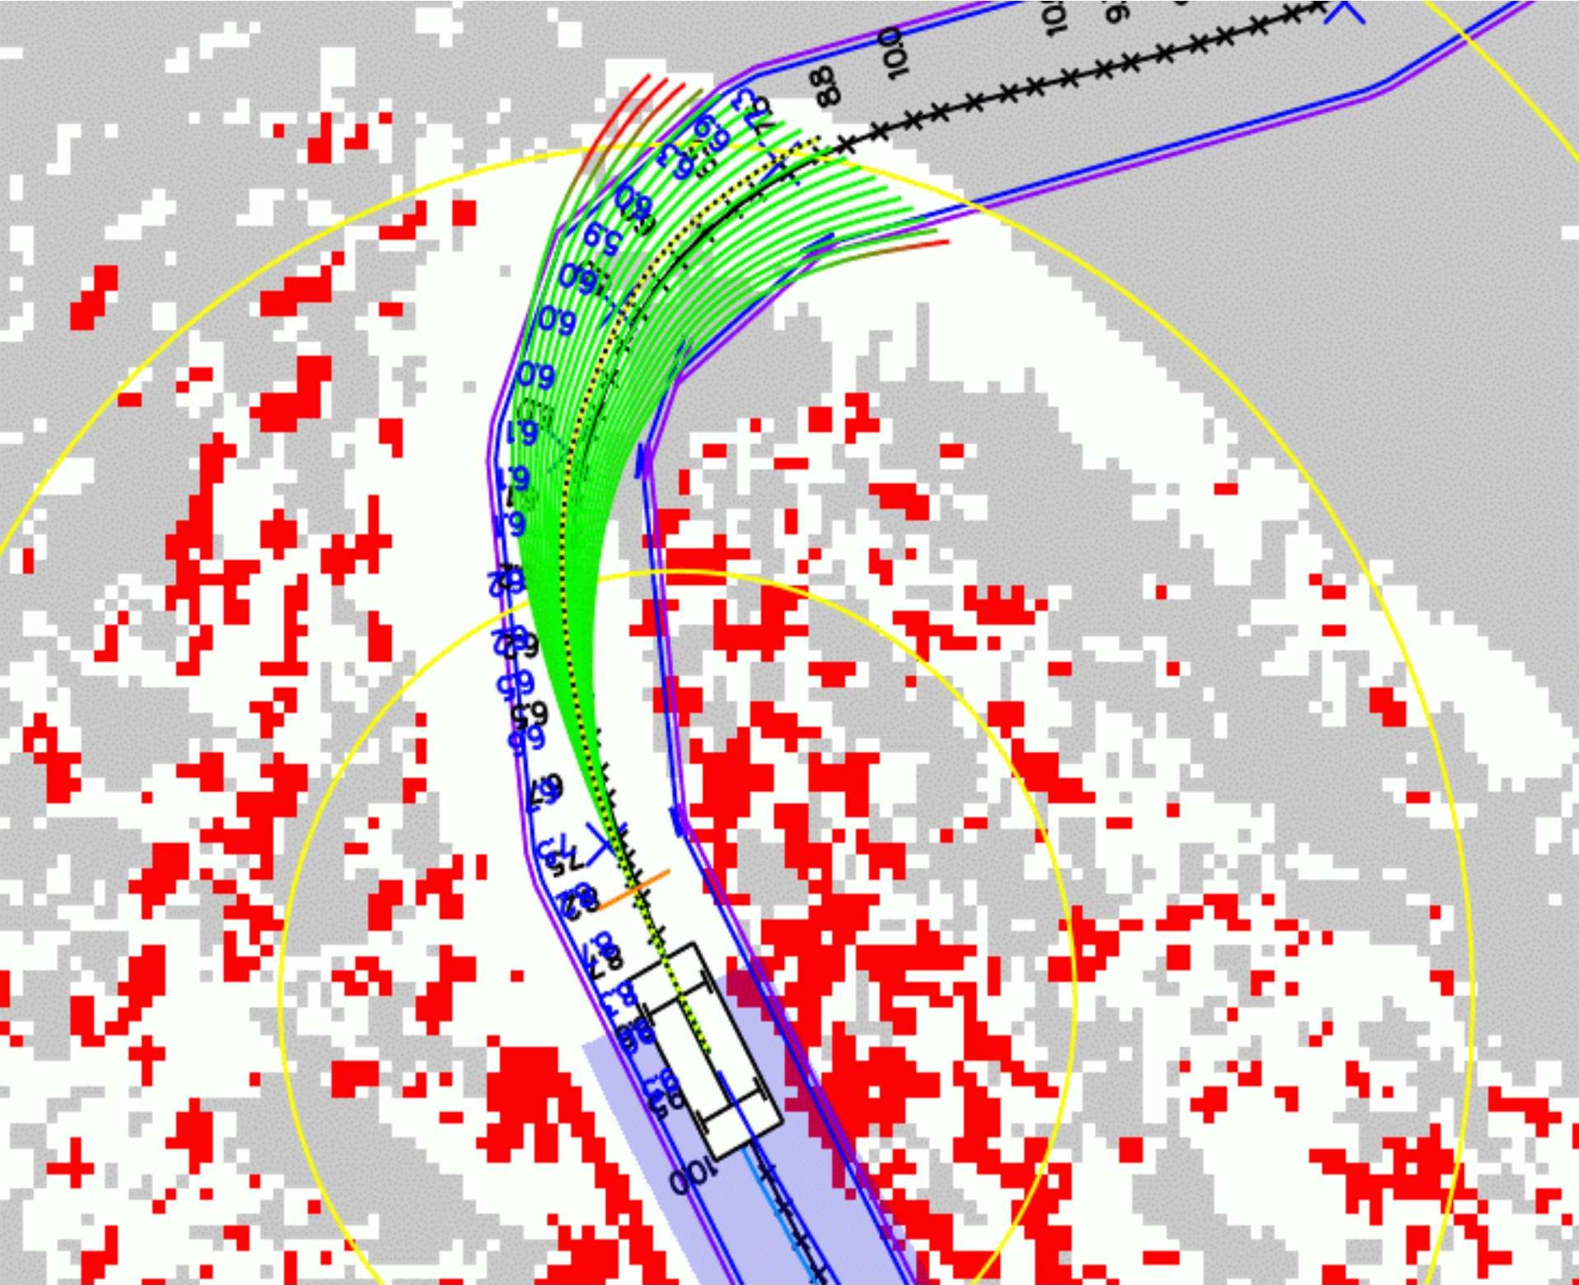

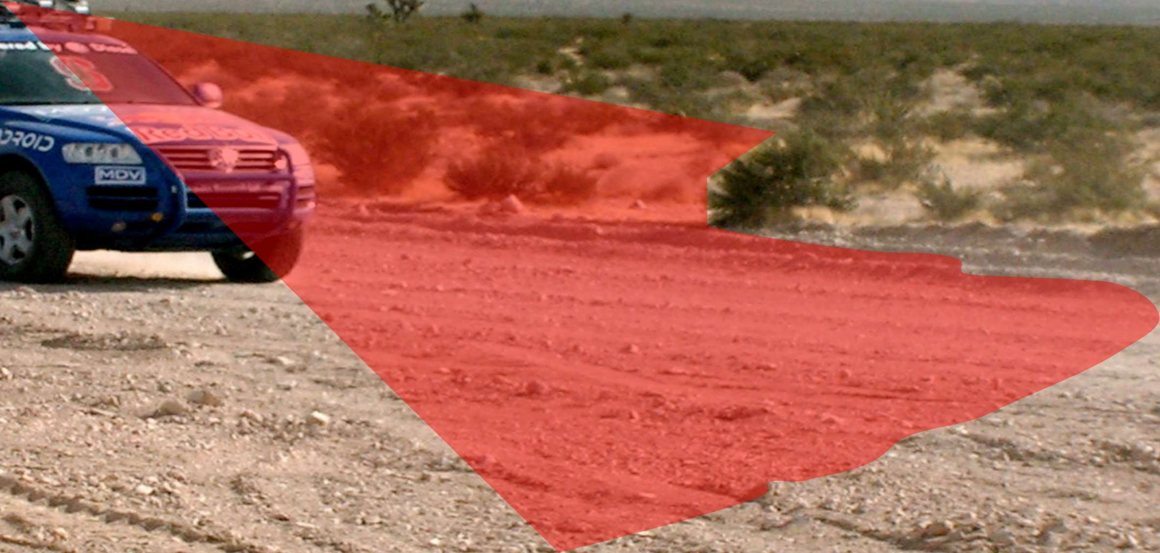




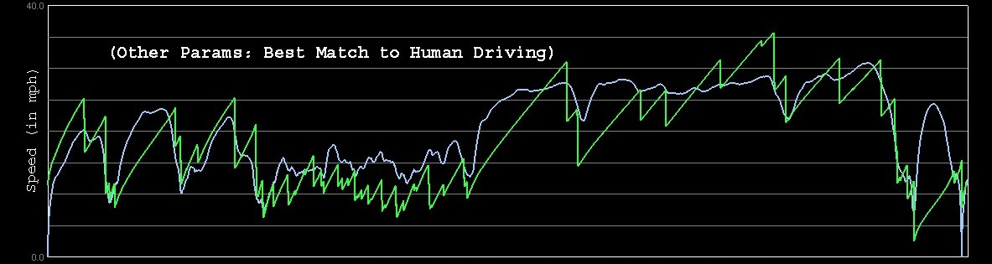
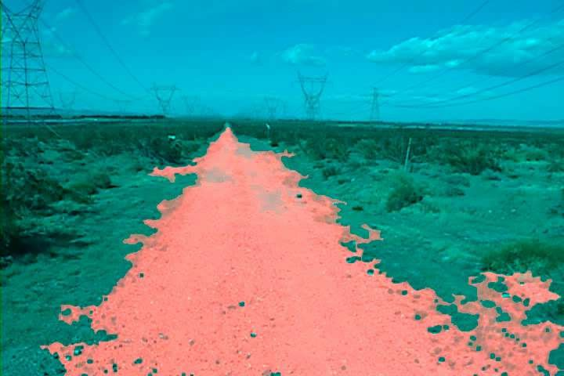









Slide 12








































Slide 13

























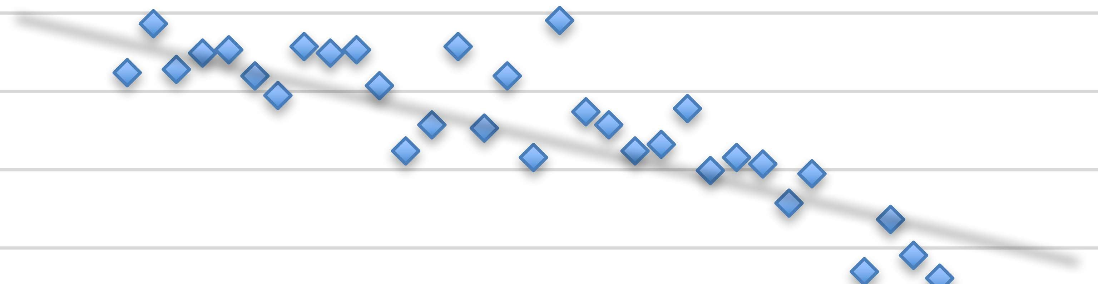












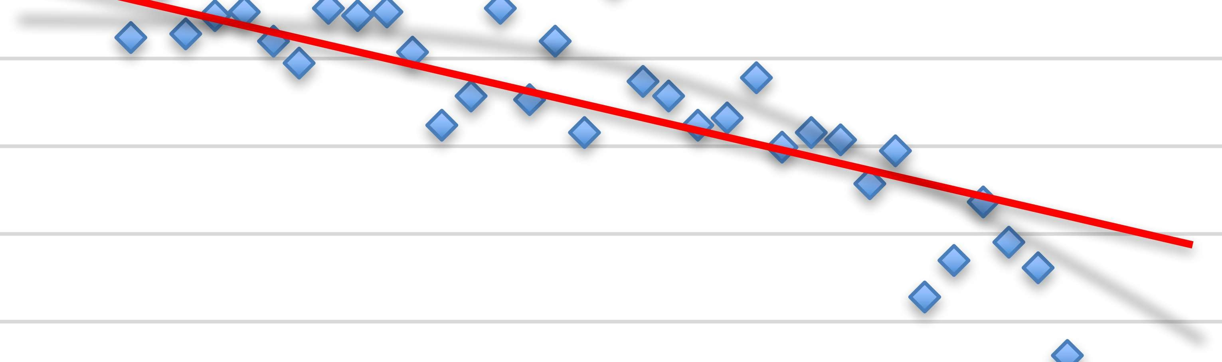























































Slide 14


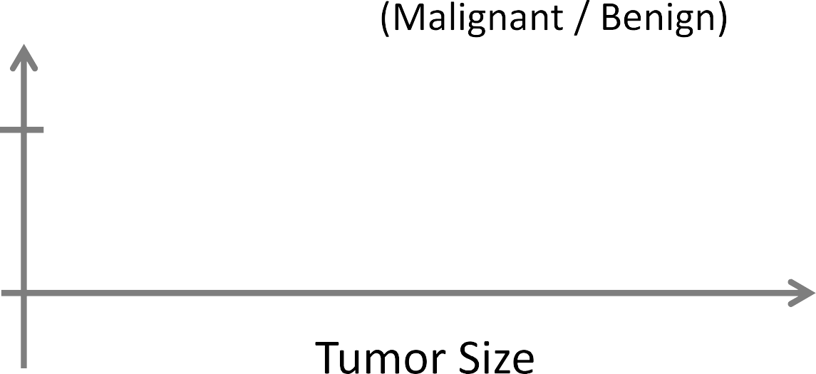













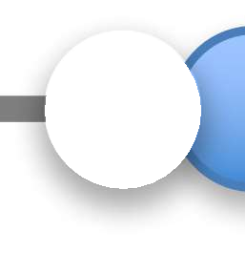












Slide 15







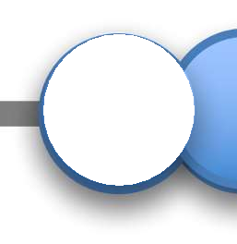
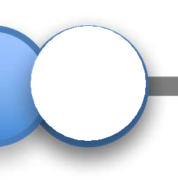












Slide 16



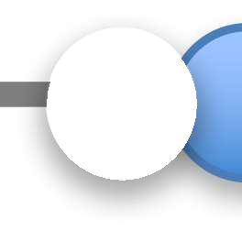








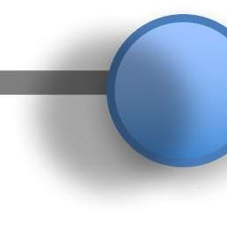
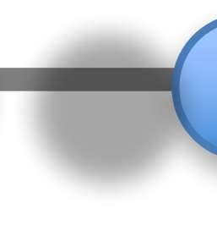









Slide 17











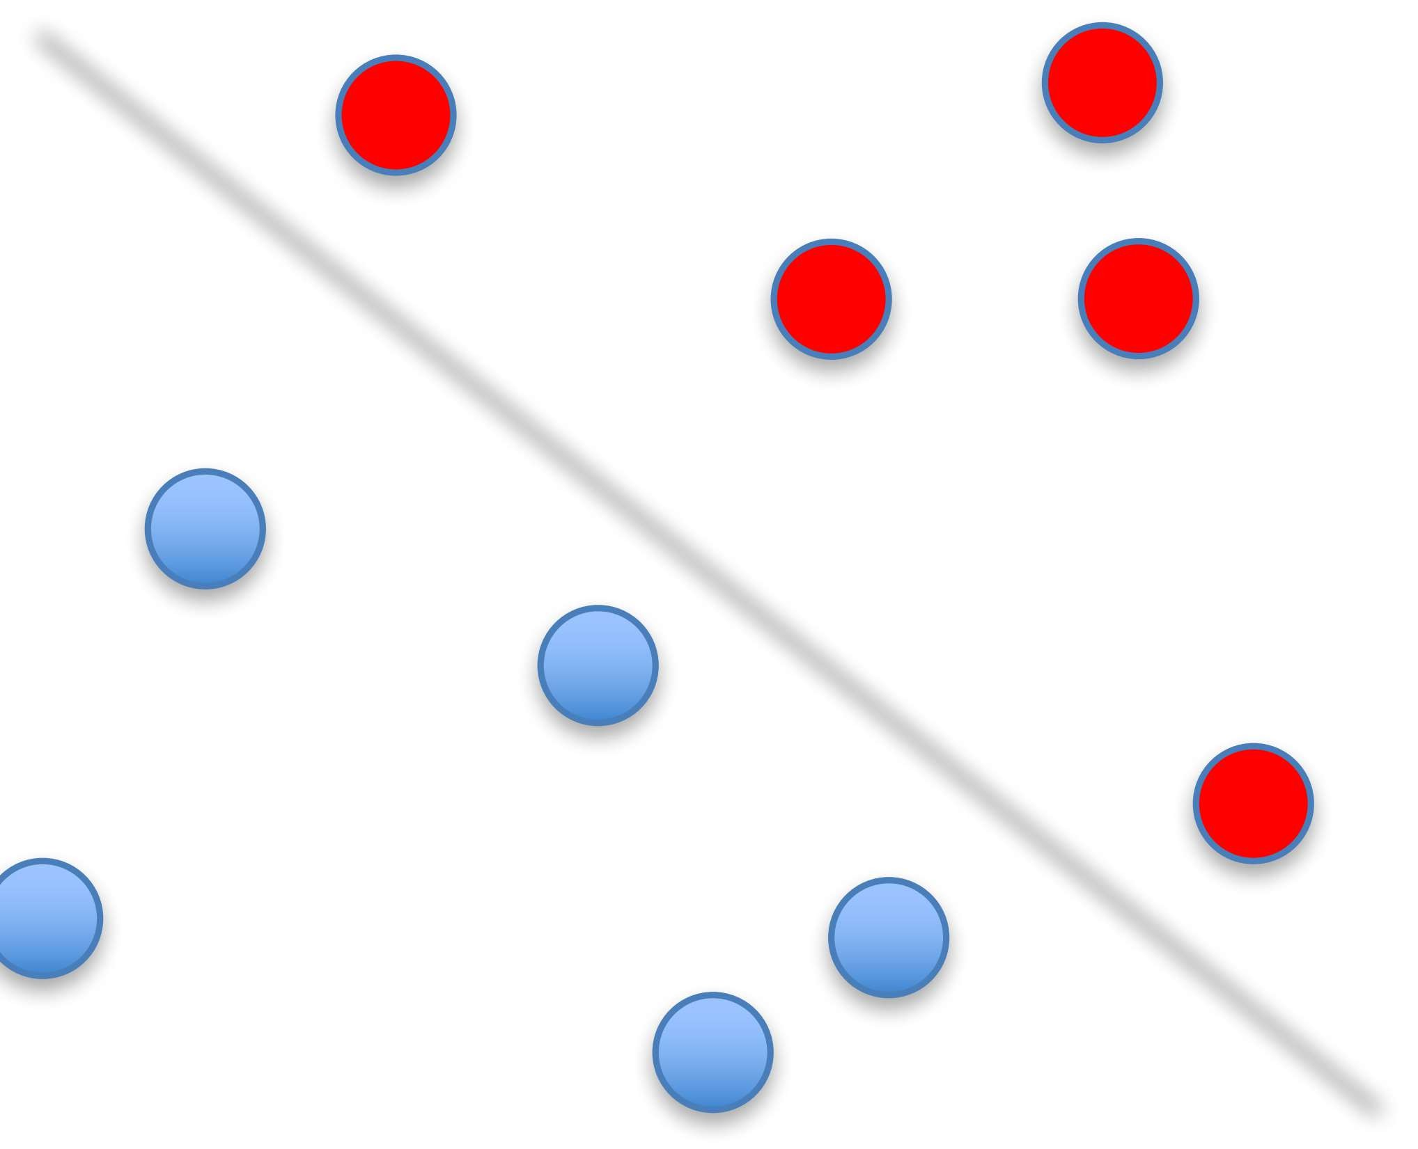
































Slide 18





































































Slide 19






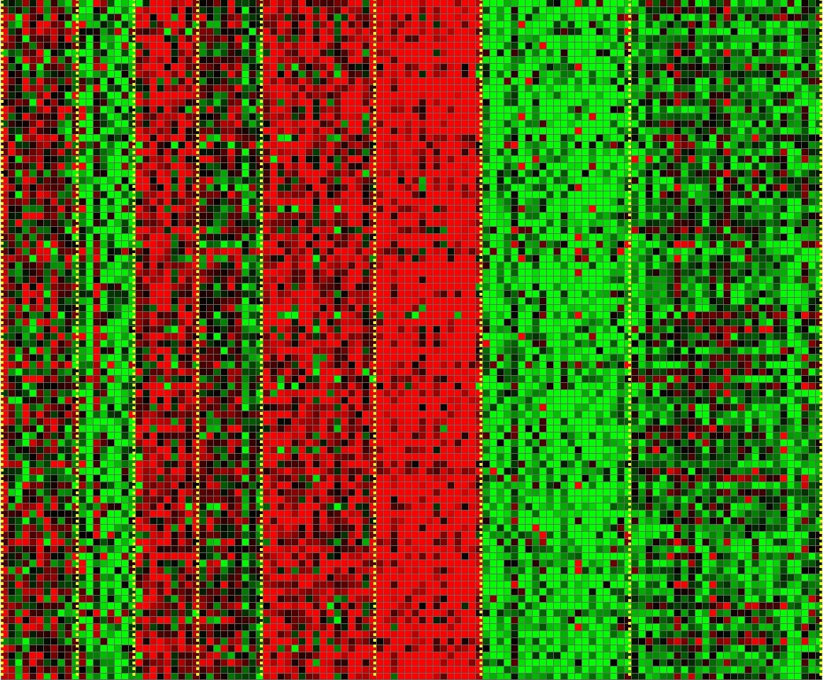



Slide 20


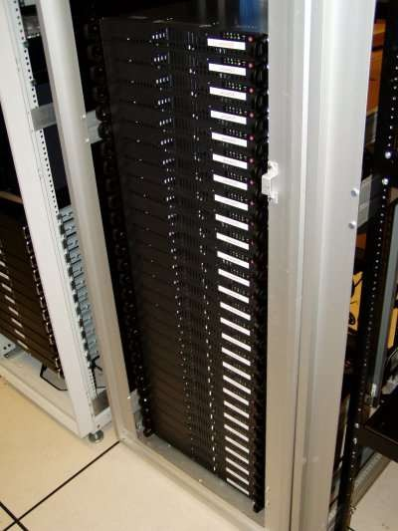
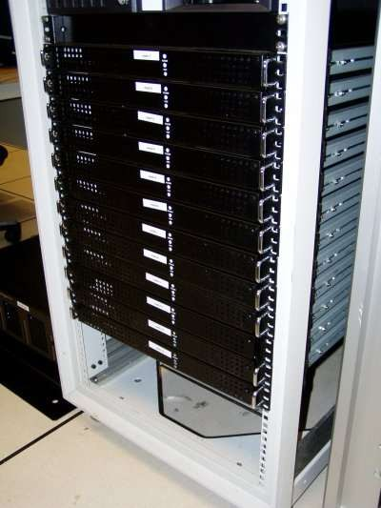














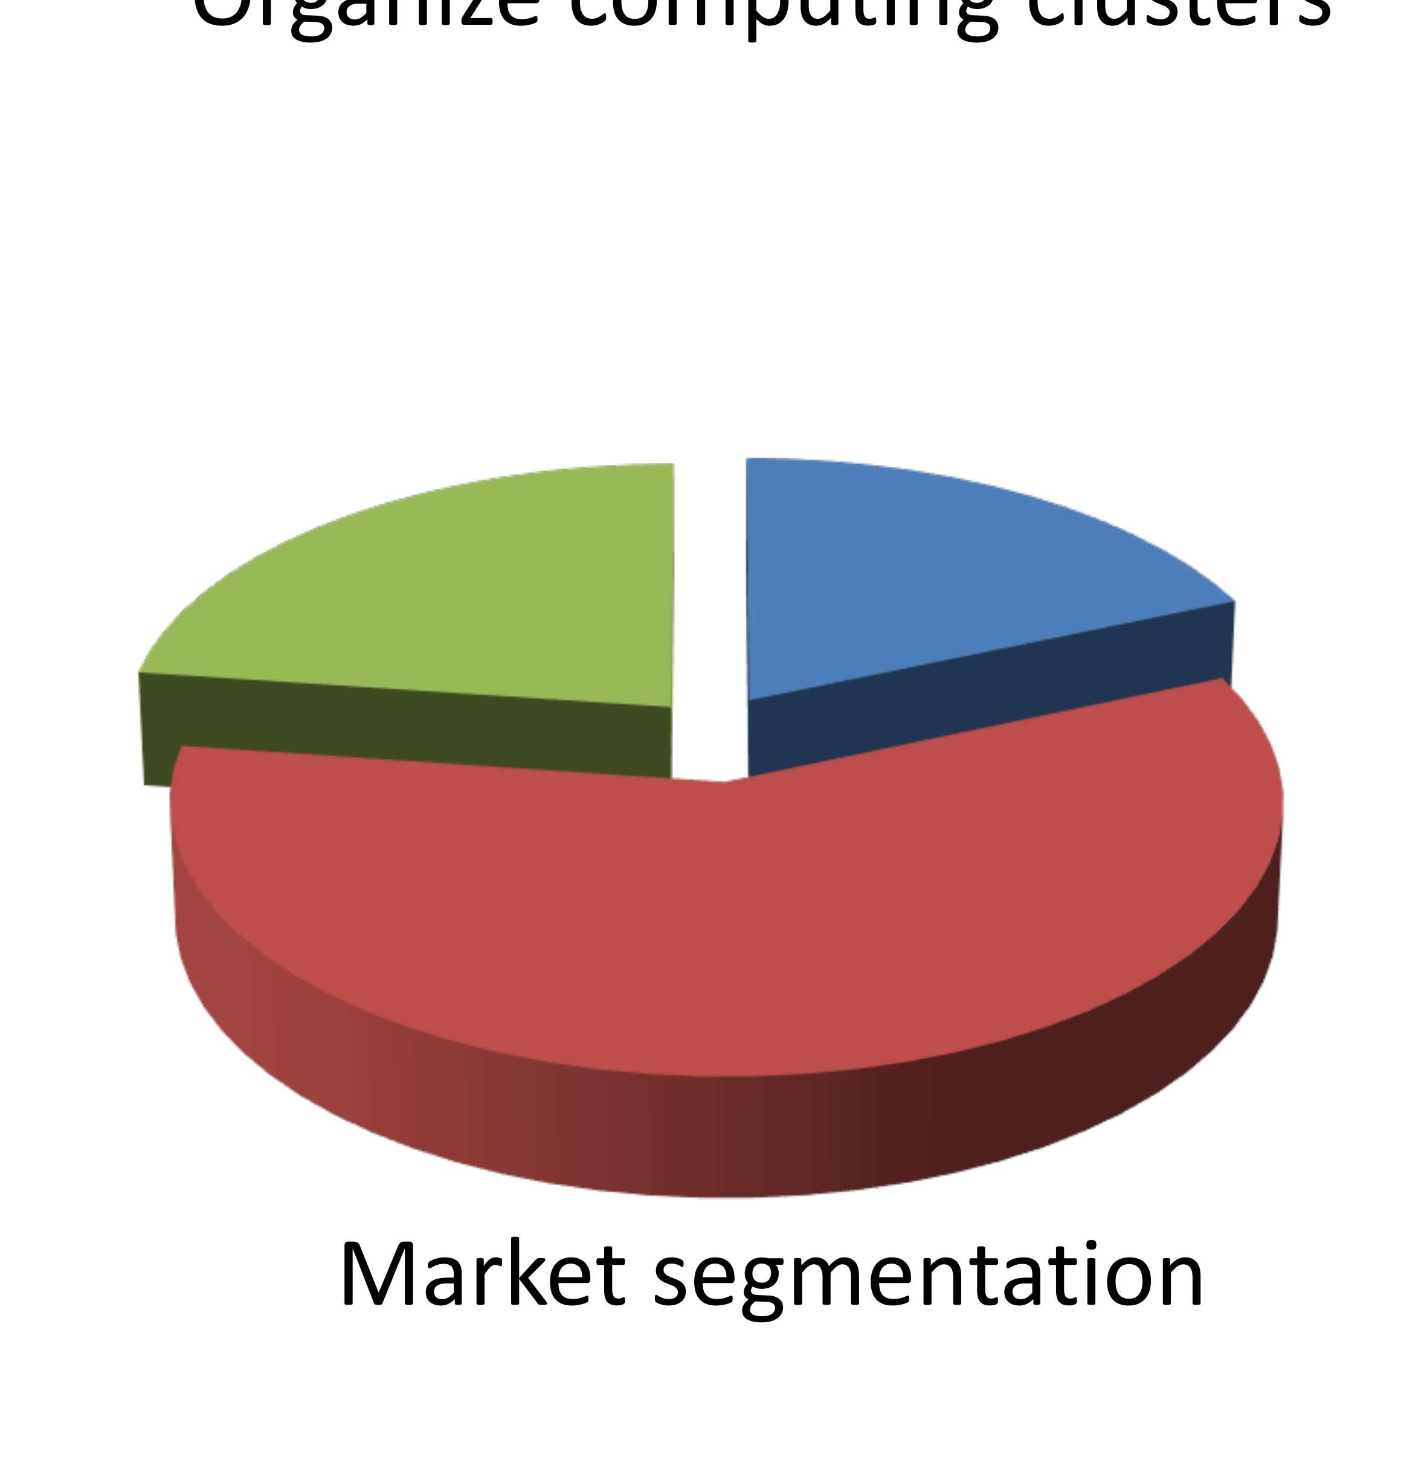



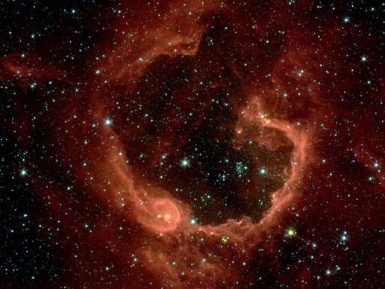


















Slide 21
























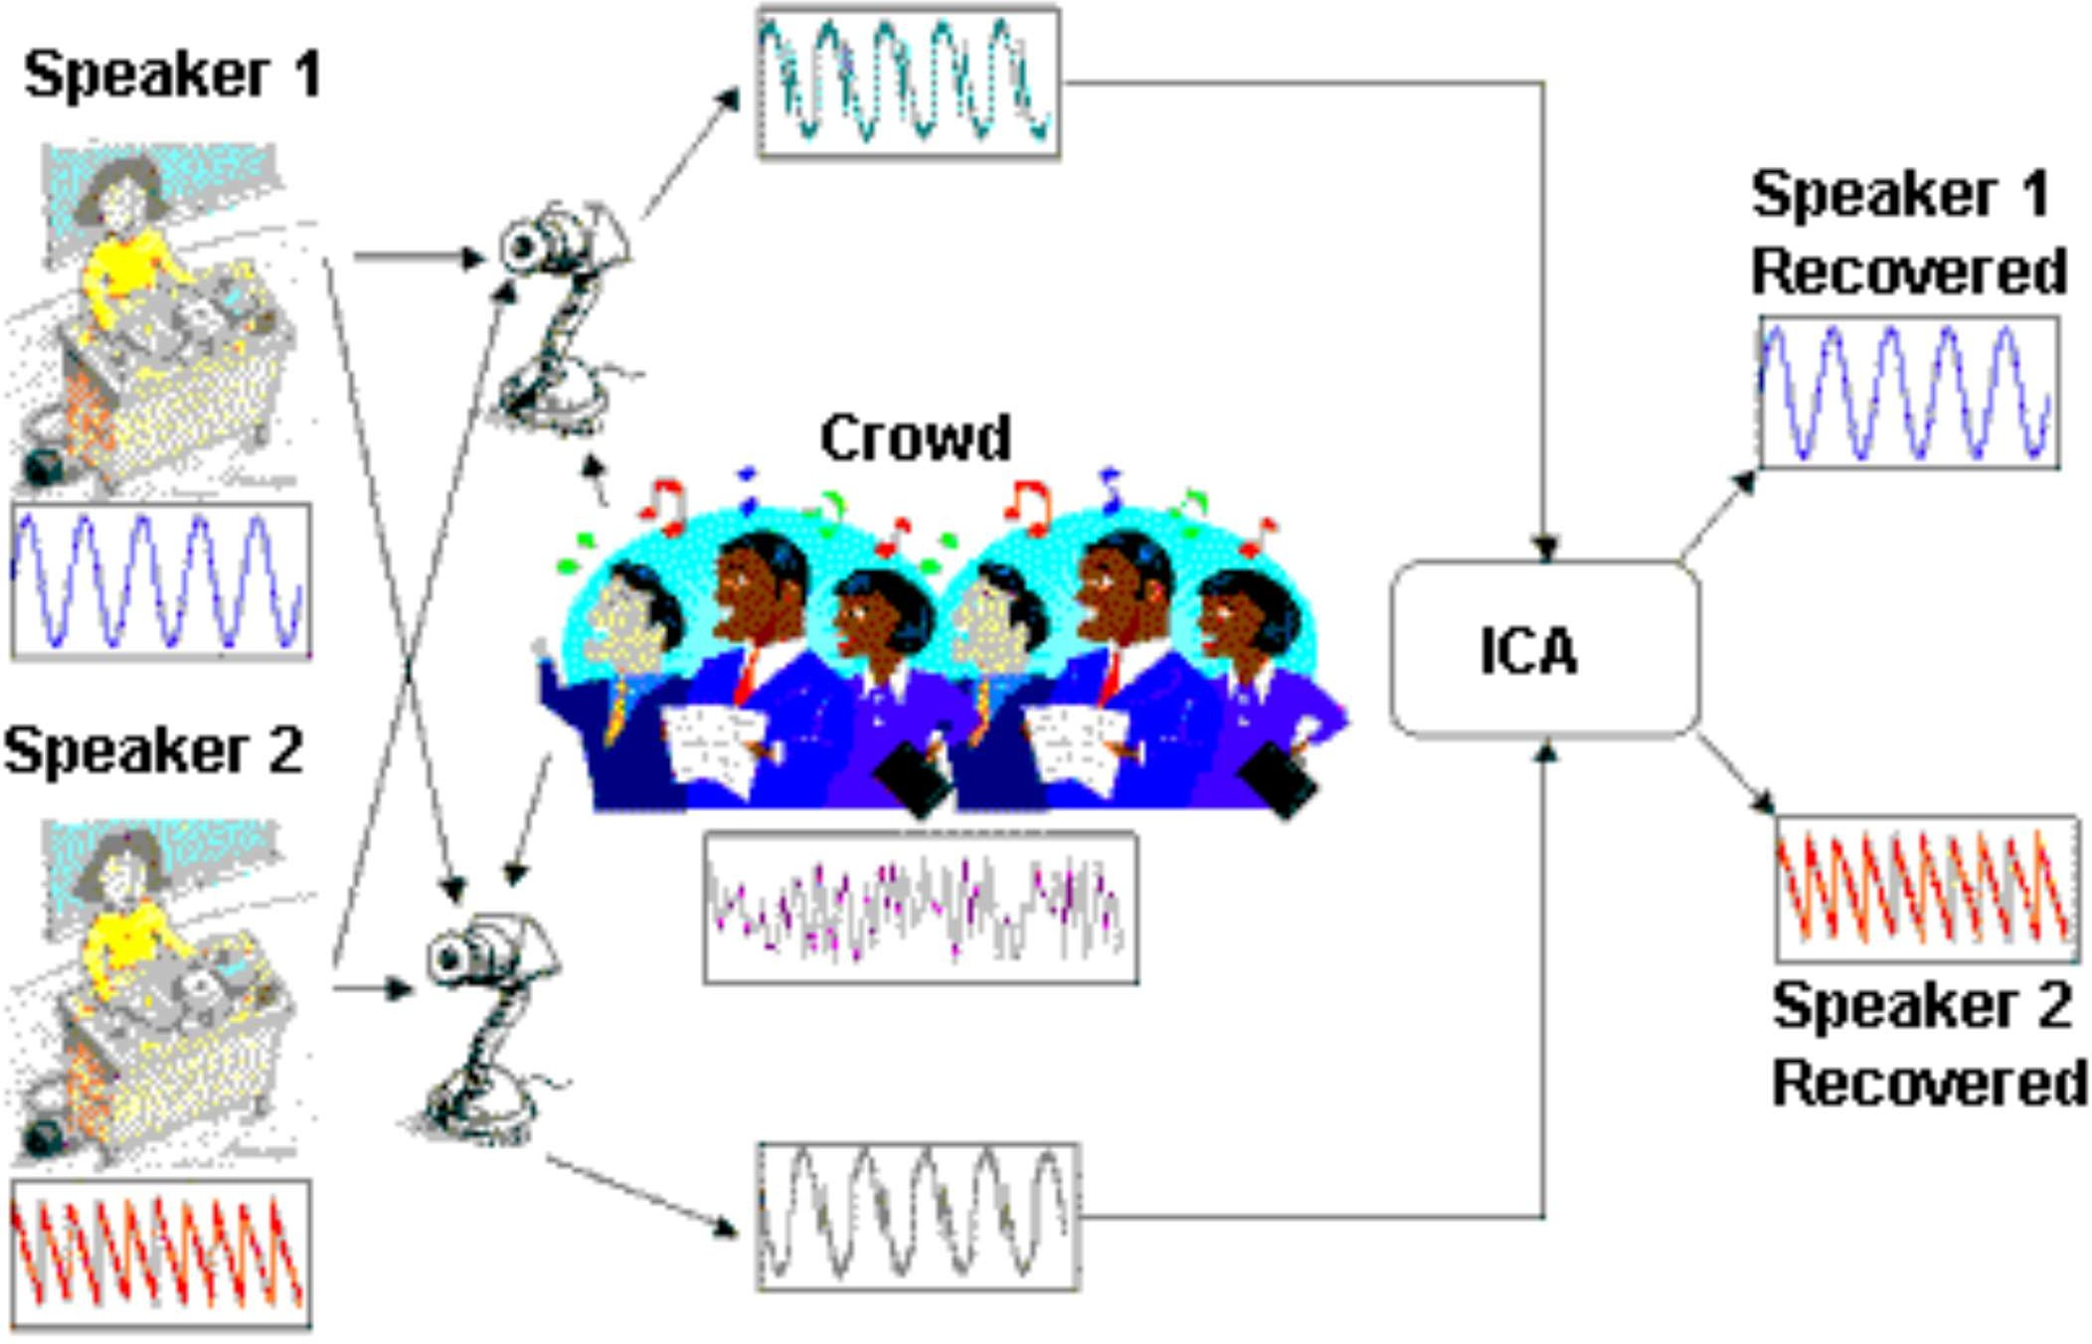




Slide 22








Slide 23

















































Slide 24










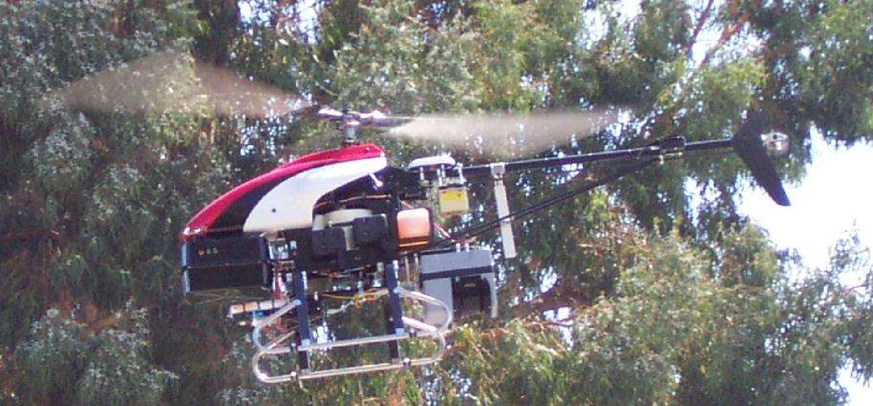




Slide 25
FUTURE AND SCOPE OF MACHINE LEARNING
Personalized AI in healthcare and education
Autonomous vehicles becoming everyday reality
Smarter assistants across all digital platforms
AI ethics guiding future tech development
Job evolution not just job loss
Global impact in climate, safety, innovation

Slide 26
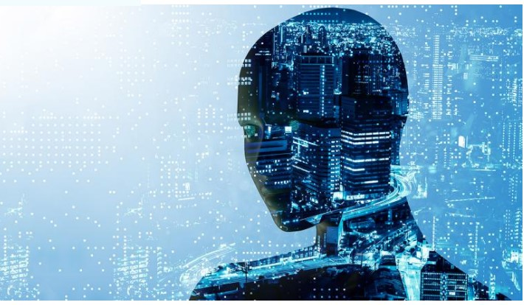

Slide 27
PROS AND CONS OF MACHINE LEARNING
✅ Pros
Learns from data automatically
Improves with more experience
Handles complex problems efficiently
Enables automation and personalization
❌ Cons
Requires large, clean datasets
Can be biased or unfair
Hard to interpret decisions
High computation and training cost

Slide 28
THANK YOU

